Slide 1
SENSOR and DC MOTOR
https://www.electronicwings.com/8051
https://www.electronicwings.com/8051/ultrasonic-module-hc-sr04-interfacing-with-8051
https://www.electronicwings.com/8051/dc-motor-interfacing-with-8051
https://webbylab.com/blog/actuators-in-iot-guide/#:~:text=Different%20Types%20of%20Actuators%20in%20IoT,-IoT%20systems%20integrate&text=The%20actuator%20transforms%20mechanical%20motion,on%20the%20IoT%20device%20requirements.

Slide 2
Sensors and Actuators-what is the difference?
Examples?
Applications
https://dzone.com/articles/type-of-sensors-and-actuators-in-iot

Slide 3
Sensors and actuators are two different components that often work together in equipment and systems to ensure they function effectively. They are opposite in terms of their functionality, but they can be found in the same areas and complement each other:
Sensors
Convert physical activity or changes into electrical signals. For example, sensors in security systems can detect unknown objects and raise alarms. Other examples include cameras, microphones, and home security systems.
Actuators
Take one form of energy as input and produce some form of motion, movement, or action. For example, actuators can regulate the flow of fuel to a gas turbine, operate valves and hydraulic cylinders in industrial plants, or drive events within equipment. Other examples include motor controllers, LED, and lasers.
Notes:
Application. Sensors are often used to measure asset temperature, vibration, pressure or fluid levels. Industrial applications of actuators include operating dampers, valves, and couplings.

Slide 4
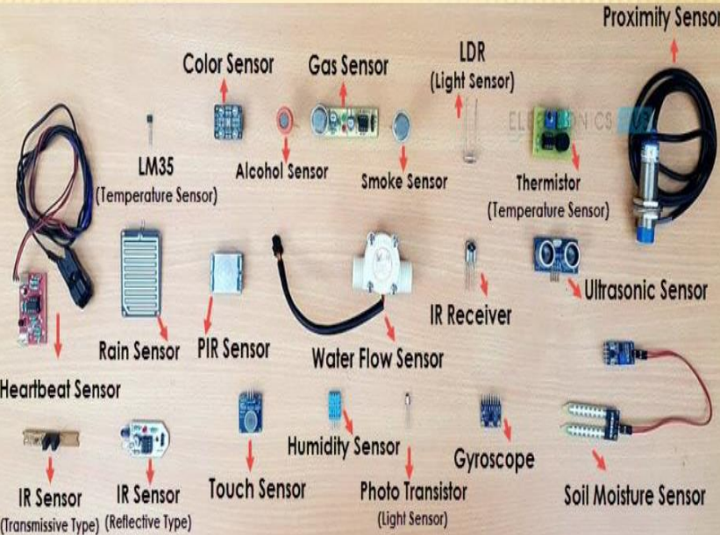
Notes:
https://kanchiuniv.ac.in/wp-content/uploads/2021/05/BMTF183T60-SENSORS-AND-ACTUATORS-1.pdf

Slide 5
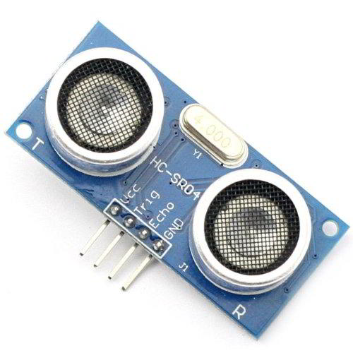
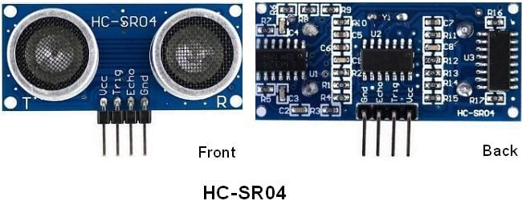
VCC: +5 V supply
TRIG: Trigger input of sensor. Microcontroller applies 10 us trigger pulse to the HC-SR04 ultrasonic module.
ECHO: Echo output of sensor. Microcontroller reads/monitors this pin to detect the obstacle or to find the distance.
GND: Ground

Slide 6
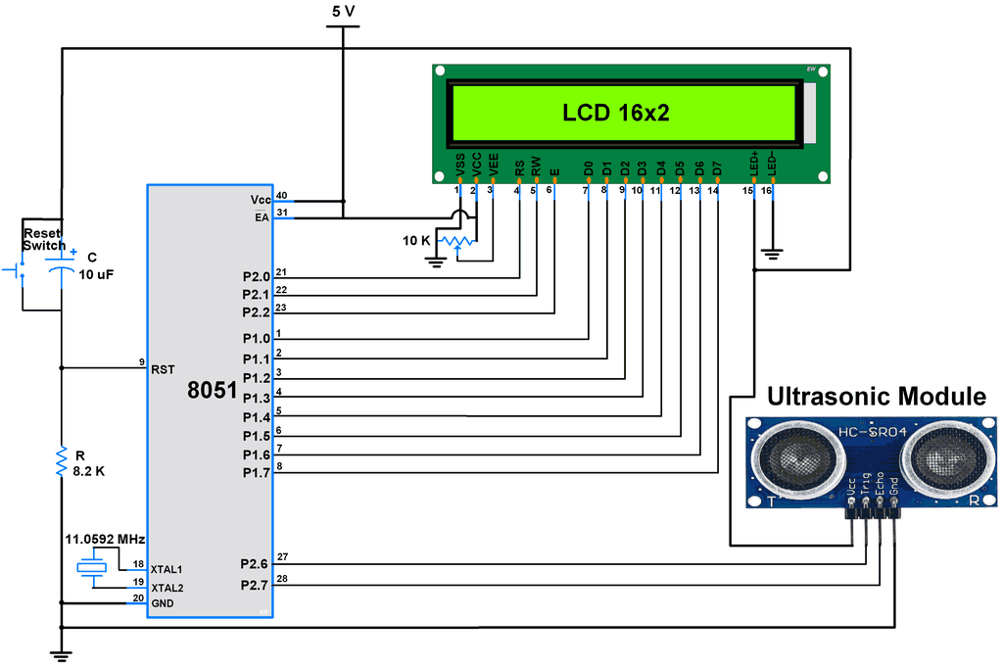

Slide 7

Steps of Programming
8051 microcontroller needs to transmit at least 10 us trigger pulse to the HC-SR04 Trig Pin.
After getting a trigger pulse, HC-SR04 automatically sends eight 40 kHz sound waves and waits for rising edge output
at the Echo pin.
When the rising edge capture occurs at the Echo pin which is connected to the input of 8051,
start Timer of 8051 and again wait for the falling edge on the Echo pin.
As soon as the falling edge is captured at the Echo pin, the microcontroller reads the count of the Timer.
This time count is used to calculate the distance to an object.
Calculation (distance in cm)
Where,
Sound Velocity = 34300 (in cm per second)
Here, the oscillator frequency of AT89S52 (8051) is 11.0592 MHz

Slide 8
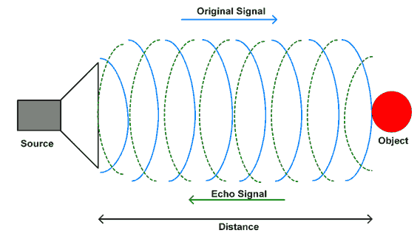
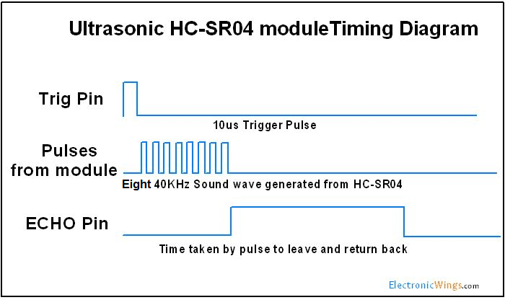
Ultrasonic Sensor HC-SR04 Working Principle

Slide 9
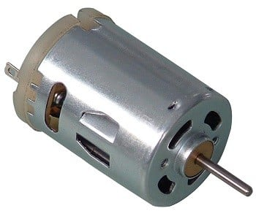
DC MOTOR INTERFACING
5v dc motor
1000 rpm
Notes:
The baud rate is the rate at which information is transferred in a communication channel,
Baud rate is the measure of the number of changes to the signal (per second) that propagate through a transmission medium. The baud rate may be higher or lower than the bit rate, which is the number of bits per second that the user can push through the transmission system

Slide 10
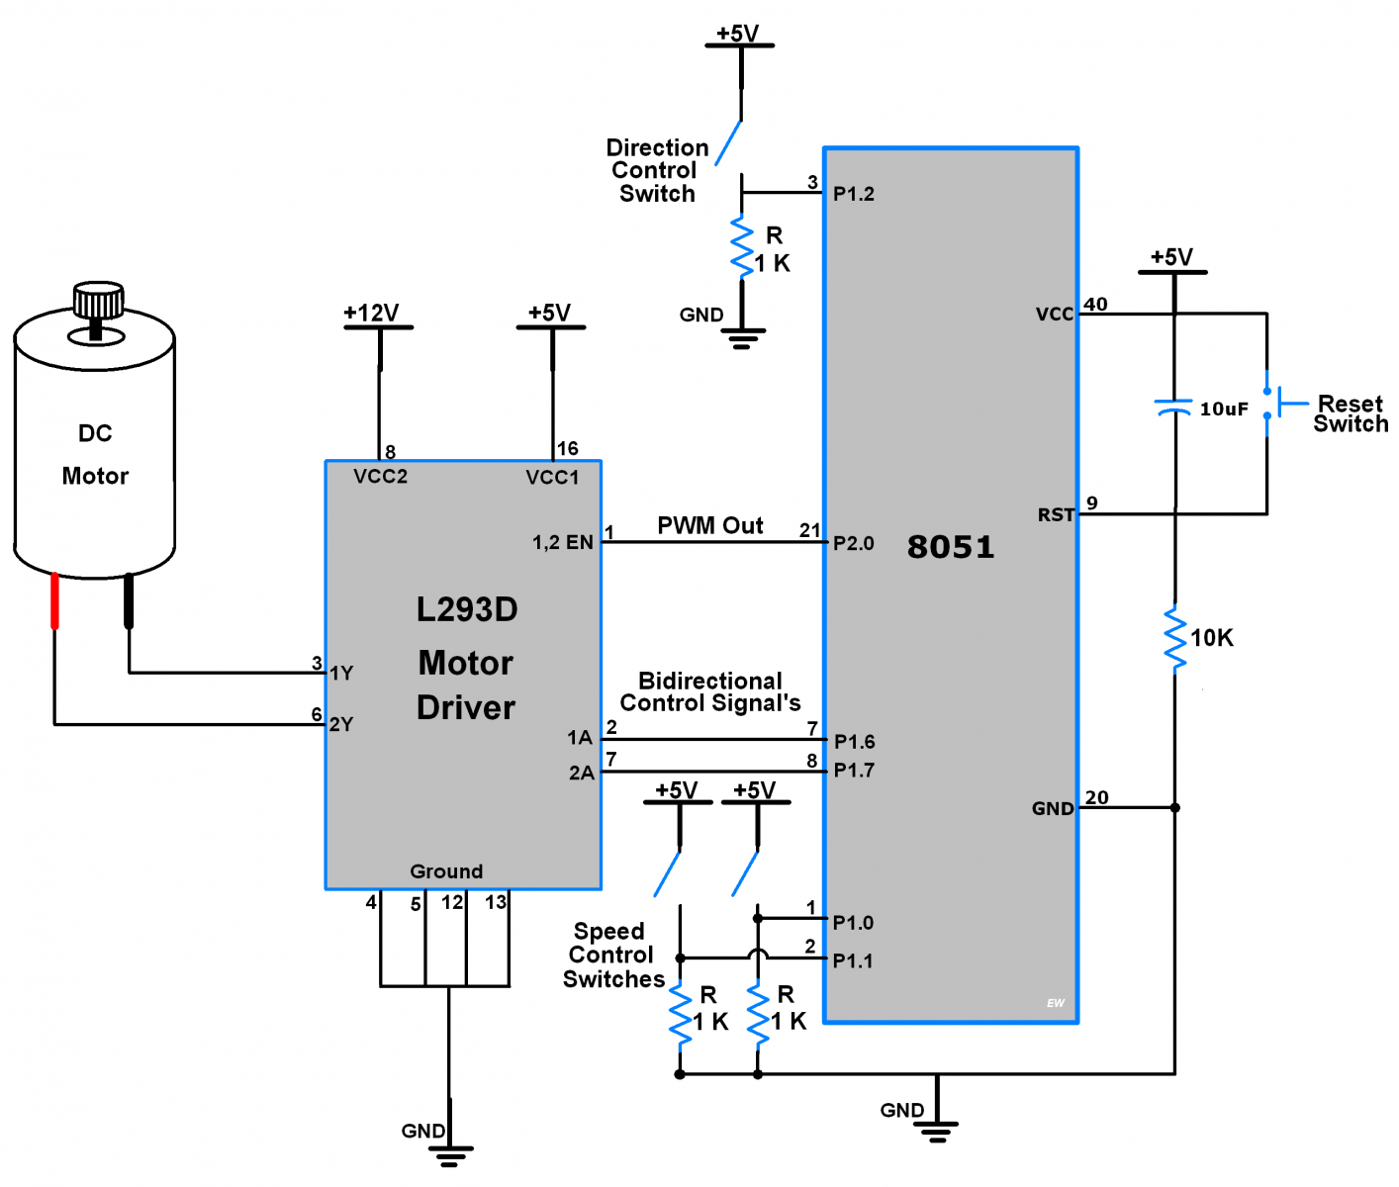

Slide 11
L293D motor driver IC to control the DC motor movement in both directions. It has an in-built H-bridge motor drive.
As shown in the above figure we have connected two toggle switches on the P1.0 and P1.1 pin of the AT89S52 microcontroller to change the speed of the DC motor by 10%.
One toggle switch at pin P1.2 controls the motor's rotating direction.
P1.6 and P1.7 pins are used as output direction control pins. It provides control to motor1 input pins of the L293D motor driver which rotate the motor clockwise and anticlockwise by changing their terminal polarity.
And Speed of the DC Motor is varied through PWM Out pin P2.0.
Here we are using the timer of AT89S52 to generate PWM.

Slide 12
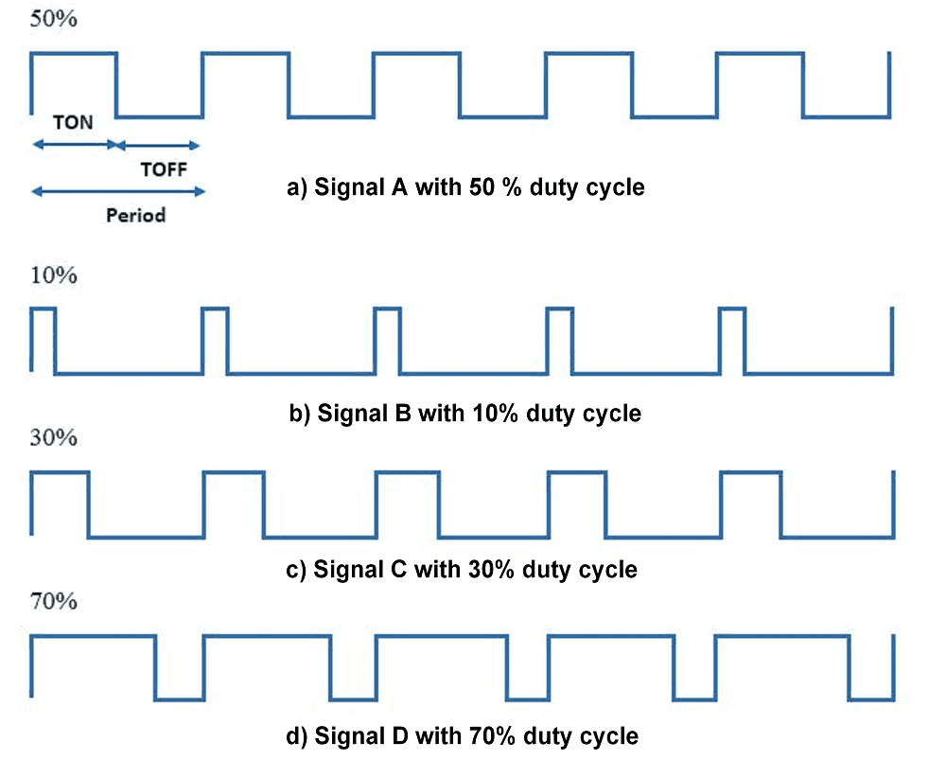
Notes:
If PWM with 50% duty cycle as shown in above figure it will provide average ≈50% voltage to the motor terminal.
So in this way we get simple DC motor speed control using PWM method.
Higher duty cycle gives higher speed and lower duty cycle gives lower speed.
We can vary pulse width precisely using Microcontroller to get fine control over DC motor.
Now, we will see how to change rotational directions of DC motors.

Slide 13
Data Bus
P1
Vout
DAC
8051

Slide 14
STEPS FOR CONTROLLING SPEED OF DC MOTOR
Find the range of the DAC (8 bit), with 5v o/p
Therefore I/P range =00 to FF
O/P range = 0-5V
Find the digital value relevant to the speed
FF=max speed =1000 rpm
3. Send the value through Port 1

